Slide 1
The very powerful fossil fuel energy companies plan to extract
oil and gas by all means necessary: conventional drilling;
fracking for tight oil and natural gas; tar sands extraction; and
deep water drilling. These vested interests will attempt to
sustain business as usual by the political influence of their
vast fortunes, their claims that they are the engine of
economic growth; sowing doubt or denying the environmental
consequences of climate warming and through legal
challenges to protect their right to extract.
Where do we stand today?

Slide 2
Coal, Oil and Gas Companies Spent More than $721
Million to Set the Anti-Environment Agenda of the New
Congress as recently reported by the Center for American
Progress
Attempts to ban fracking by local communities in Colorado
have faced an aggressive legal response by energy
companies in city after city arguing that they
have a right to extract underground minerals, and that
drilling bans amount to voter-approved theft. They also
say state agencies, not individual communities,
are the ones with the power to set oil and gas rules.
N.Y. Times 12/4/2015

Slide 3
What should we expect if business as usual continues?
As of 2011, approximately 89 million barrels of oil and
liquid fuels were consumed per day worldwide.
That works out to nearly 32 billion barrels a year.
In the next five years, almost half of global oil demand
growth will come from China, and this trend is set to
continue to 2035, as oil demand from the transportation
sector is growing strongly in countries such as China and
India.
Global demand for coal over the next five years will continue marching higher, breaking the 9-billion-tonne level by 2019, the International Energy Agency (IEA) said in its annual Medium-Term Coal Report.

Slide 4
International Energy Agency-Energy Technology Perspectives
2014 Executive Summary list three possible energy futures to
2050
6ºC Scenario (6DS), where the world is now heading with potentially devastating results.
4ºC Scenario (4DS) reflects stated intentions by countries to
cut emissions and boost energy efficiency.
2ºC Scenario (2DS) offers a vision of a sustainable energy
system of reduced greenhouse gas and carbon dioxide
(CO₂) emissions.

Slide 5
After the Copenhagen Climate Conference of 2009 I was
very depressed that so little was achieved. Could we
transition from predominant fossil fuel use to
employing renewable energy exclusively? To learn more
about potential solutions to climate warming I started to
attend annual meetings of the National Council for
Science and The Environment here in Washington.
At the 2012 NCSE meeting I heard Amory Lovins discuss
the Rocky Mountain Institute’s strategies for a new
energy era in the US by 2050 that would almost exclusively
use clean energy coupled with a host of energy efficiency
and renewable energy strategies. The blueprint for these
strategies was laid out ina book entitled- Reinventing Fire.

Slide 6
Reinventing Fire is a 334 page book covering energy
issues in transportation, buildings, industry, and
electricity.
Before giving a very limited description of two of the
energy strategies, I suspect that there are a
number of you who would like to know what is the
Rocky Mountain Institute (RMI)?
“RMI is an independent , nonprofit think-and-do
tank that drives the efficient and restorative use of
resources by transforming design, busting barriers,
and spreading innovation.” Page IX Reinventing Fire.
It was founded by Amory Lovins over 30 years ago.

Slide 7
The Transportation chapter focuses on designing and building automobiles differently. Much greater energy efficiency can be achieved with ultra-light weight material construction, aerodynamic body style that reduces drag and electrified power trains. This design concept was first developed in 1994 by Amory Lovins and called the Hypercar.
Revolutionary autos can be produced with ultralight
materials such as carbon fiber composites.
Since the weight of the auto is substantially reduced the
batteries for an electrified power train can be much
smaller. The conceptual framework of the Hypercar has
found acceptance by BMW and VW as illustrated next.

Slide 8
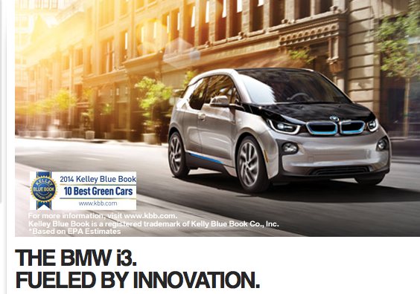
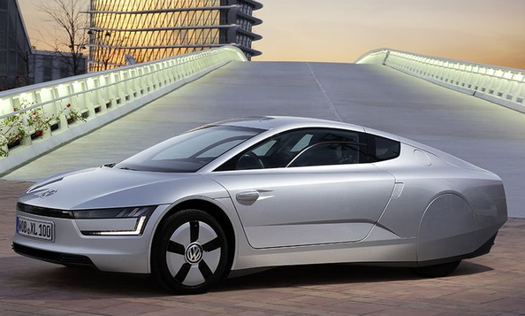
VW XL1

Slide 9
Electricity Chapter
The goal is to eliminate fossil fuels cost effectively
from the US electricity system by producing at
least 80% of the electricity from renewable resources
by 2050.
As part of this transformation there will be a need to have
solar installed on 50-75% of the homes. Consequently,
lower costs for solar are essential. RMI is working on ways
to reduce labor installation costs and the cost of financing
solar.

Slide 10
Solar installation coupled with capacity to return electricity to the grid (net metering) opens the electricity system to distributed power systems. Distributed solar PV opens a number of technical issues, e.g., finding ways to optimizing distributed solar PV’s generation with both the grid’s needs and the customer’s demand. Finding mechanisms that provide “wins” for customers, solar companies, and utilities can accelerate, optimize, and sustain distributed solar PV adoption. If we envision that the latter can be accomplished and coupled with other developments what will the electricity system look like in 2050?

Slide 11
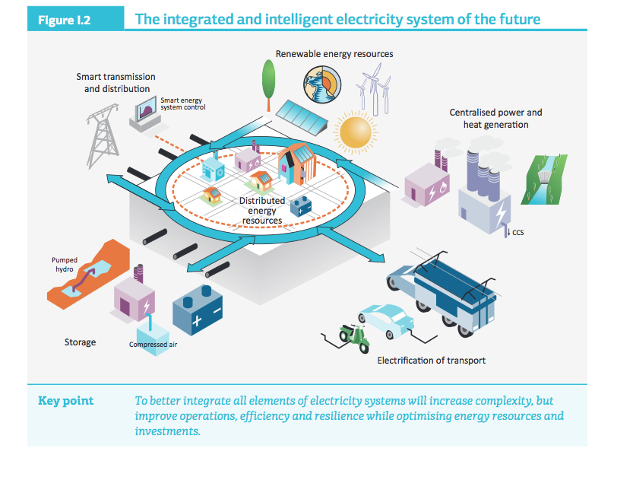
From Energy Technology Perspectives 2014 Executive Summary International Energy Agency

Slide 12
In the preface to Reinventing Fire Amory Lovins states the following: “ Imagine fuel without fear. No climate change. No oil spills, dead coal miners, dirty air, devastated lands, lost wildlife. No energy poverty. No oil fed wars, tyrannies, or terrorists. Nothing to run out. Nothing to cut off. Nothing to worry about. Just energy abundance, benign and affordable, for all, for ever.”

