Slide 1
International Code Council (ICC)
Non-profit member focused association
  Approximately 50,000 members
  Develops the I-Codes (15 codes)
Established in 1994
  Combined BOCA, ICBO, & SBCCI
  First I-Code edition in 2000
Utilizes Governmental Consensus Process to develop I-Codes
Training/education & Certification

Slide 2
IgCC - History
  2009: Research and development of IgCC
    Sustainable Building Technology Committee formed – 29 members from public, private, and non-profit sectors
  2010: ICC, AIA, & ASTM joined by Cooperating Sponsors USGBC, IES, & ASHRAE to publish Public Version 1.0
    Public comments occur
    Version 2.0 published in November
  2011: Public Version 2.0 enters Code Development Cycle
  2012: 2012 IgCC published

Slide 3

IgCC Context
  The IgCC is not a rating system, nor is it intended to replace them.
  The IgCC is code which is intended to be adopted on a mandatory basis.
  The IgCC primarily consists of minimum mandatory requirements, just as other I-Codes.
  The IgCC contains a new regulatory framework that facilitates both jurisdictional customization and flexibility for owners and designers.

Slide 4
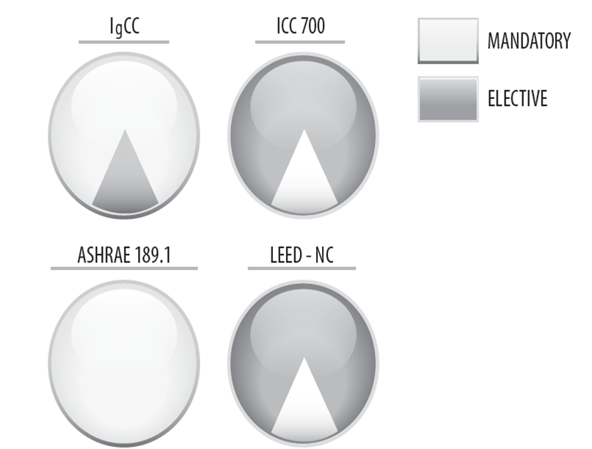
Mandatory vs. Elective Provisions

Slide 5
Chapter 3: Jurisdictional Requirements and Life Cycle Assessment
Jurisdictional Requirements
  A new regulatory framework
  Allows jurisdictions to customize the code to address 20 additional environmental criteria
  This criteria may not be appropriate for all jurisdictions.
  May be beneficial in others.
  Allow the jurisdiction to set higher minimum levels of performance.
  Whole Building Life Cycle Assessment
  Not a mandatory requirement.
  An alternative to the material selection requirements of Section 505.
Notes:
A total of 20 possible Jurisdictional Requirements – including application of ICC-700; Site Development and Land Use (chapter 4); Material Resource Conservation and Efficiency (chapter 5); Energy Conservation and Carbon Emission Reduction (chapter 6); Water Resource Conservation (chapter 7); Indoor Environmental Quality and Comfort (chapter 8); Existing Buildings (chapter 10).
Whole Building Life Cycle Assessment – Assessment of environmental impacts with all stages of a building’s life from cradle-to-grave
5

Slide 6

Chapter 4: Site Development and Land Use
Preservation of natural resources (Tied to T302.1)
  Allows jurisdictions to prohibit construction in floodplains and limit development of certain sites and site features
  Natural resources inventory required
Stormwater management
Landscape irrigation
Management of vegetation, soils and erosion control
Building site waste management
Transportation impact
Heat island mitigation
Site Lighting (Tied to T302.1)
Notes:
402 Preservation of Natural Resources
Prohibits construction in floodplains.
Generally prohibits building within 50 feet (1524 mm) of bodies of water and wetlands (with exceptions)
Generally prohibits construction on park land (Section 402.2.4)
Requires natural resources inventory (Section 402.3.1)
Additional provisions for stormwater, erosion control, landscape irrigation, debris and soil recycling.
403 Transportation Impact
Encourages alternative transportation (bicycling, pedestrian, alt vehicles, public transit)
404 Heat Island Mitigation
Projects located in Climate Zones 1 through 6 must implement heat island mitigation practices for at least 50 percent of site hardscape.
Projects located in Climate Zones 1 through 3 must implement heat island mitigation practices for at least 75 percent of roof surfaces.
405 Site Lighting
Minimize light pollution

Slide 7

Chapter 5: Material Resource Conservation and Efficiency
Construction material and waste management plan
  50% construction waste diversion min.
  Jurisdictions can select higher values in Table 302.1
Requires recycling areas for use by building occupants
55% of materials must be:
  Recycled,
  Recyclable,
  Bio-based, or
  Indigenous.
  (Materials are permitted to have multiple attributes.)
Mercury limits for fluorescent lamps
Moisture control
Notes:
Construction Material and Waste Management Plan
At least 50 percent of construction phase waste materials must be diverted from landfills.
Allows the jurisdiction to increase levels to 65 percent or 75 percent in Table 302.1.

Slide 8
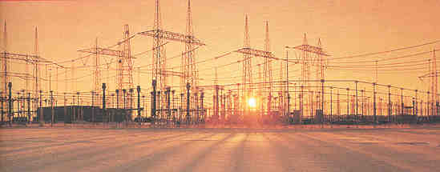
Chapter 6: Energy Conservation, Efficiency & CO₂e Emission Reduction
Chapter 6 is applicable to new buildings and additions to existing buildings.
Contains detailed energy requirements.
Energy requirements for alterations to existing buildings are found in Ch 10.
The IgCC provides the following energy compliance paths:
  Prescriptive-based –
  Performance-based zEPI (Zero Energy Performance Index)
8
Notes:
Outcome based performance [or Annual Net Energy Performance (ANEP) based] compliance:
Available for buildings of all sizes
Must have an ANEP no greater than that required for the occupancy or that determined by the jurisdiction
Peak energy demand must comply with IECC
Requires commissioning reports and annual operation reports
Must comply with IGCC Sections 604, 605 & 612
Requires a significant amount of information to be determined by the jurisdiction and entered in Tables 603.2(1), 603.2(2) and 603.2(3).
IGCC’s Energy Use Intensity (EUI) compliance path:
Is available for buildings of all sizes
Requires EUI that is in the top 10 percent of existing buildings eligible to a receive a score in EPA’s Target Finder program or
For buildings not eligible for a score in Target Finder, must be designed to deliver an EUI that is at least 50 percent lower than the average EUI for similar buildings in DOE’s SBECS
Determine EUI in accordance with the following equation:
EUI = TAE/SF (where TAE = Total annual energy projected to be consumed on site, including renewable energy; and SF = building gross square footage) (Section 602.2.4.1)
ZEPI of 51 (baseline) is equivalent to 2012 IECC

Slide 9

Chapter 7: Water Conservation and Efficiency
Seeks water efficiency regardless of the source
Encourages the use of lower quality water wherever possible and permissible.
Efficiency provisions for
  Plumbing fixtures/fittings
  Appliances
  Carwashes
  Cooling towers
HVAC systems and equipment Water treatment systems
Metering
Rainwater collection systems
Gray water reuse systems
Reclaimed water systems
Other alternative water sources

Slide 10

Chapter 8: Indoor Environmental Quality and Comfort
Indoor Air Quality Management Plan Required
HVAC & Air-handling systems
  Air-handling system access
  Durability and cleanability
  Filters
  Ventilation requirements
Prohibits smoking in buildings
IAQ construction phase requirements
IAQ & pollutant control measures
Material emissions limits
Acoustics (Tied to T302.1)
Daylighting
Notes:
The Building Air Quality guide, developed by the EPA and the National Institute for Occupational Safety and Health, provides practical suggestions on preventing, identifying, and resolving indoor air quality (IAQ) problems in public and commercial buildings. This guidance provides information on factors affecting indoor air quality; describes how to develop an IAQ profile of building conditions and create an IAQ management plan; describes investigative strategies to identify causes of IAQ problems; and provides criteria for assessing alternative mitigation strategies, determining whether a problem has been resolved, and deciding whether to consult outside technical specialists.
System components requiring unobstructed access for cleaning and repair include, ducts, air handler units, fans, coils and condensate pans.
Although not stated explicitly, there are indirect references to the Friability of materials in Section 802.3. Friability meaning the ability of a solid substance to be reduced to smaller pieces with little effort.
Often, substances designated as being hazardous, such as asbestos or crystalline silica are referred to as being friable if they are present in such a state that it is possible for small particles to become dislodged, thus enabling them to become respirable (able to enter human lungs), posing a health hazard. Polyurethane foams, can increase in friability with exposure to ultraviolet radiation (such as is present in sunlight).
Examples include but are not limited to: Clumps of dried clay, Chalk, Stone, Tablets, Crackers, Perlite, Mineral fibers, Polyurethane (foam), and Aerogel.

Slide 11
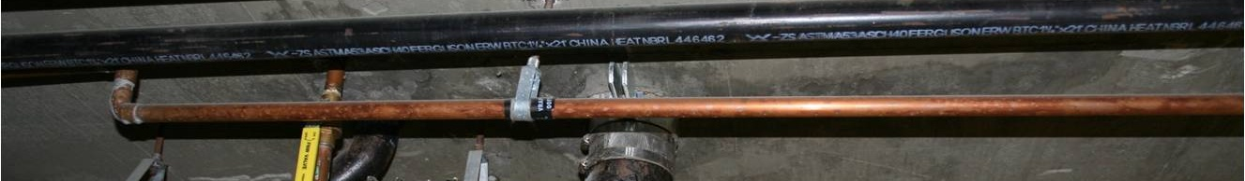
Chapter 9: Commissioning, Operations & Maintenance
Pre-occupancy inspection and testing
Operation and maintenance manual
Building maintenance schedules
Addresses many issues beyond energy
Commissioning (T903.1)
  List of items for which commissioning is required or encouraged
  Distinguishes between pre-occupancy and post-occupancy commissioning
Notes:
Modeled after
Special inspections criteria in Chapter 17 of the IBC and
Commissioning criteria found in the IECC

Slide 12
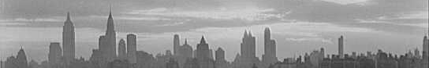
Chapter 10: Existing Buildings
Alterations/renovations:
  Loosely based on IBC Ch 34.
  Whatever is changed must meet current IgCC requirements.
  Unaltered components can remain as they are
  Requirements primarily related to energy & water
  Capped at10% of the total cost of alterations & other exceptions.
Additions are treated much like new construction.
Historic buildings exempted from many provisions
Jurisdictions can choose to offer the evaluation of existing buildings for IgCC compliance.
Chapter 11 covers similar info for building sites.
Notes:
Alterations to existing buildings: energy used after the alteration must not exceed the energy used prior to alterations.
Section 1002.1: Prohibits the construction of additions to buildings in flood hazard areas.
Exception: where all habitable space is located at least 1 foot above flood elevation.
Alterations to Existing Buildings:
Basic prescriptive requirements addressing:
Leaks
Defective equipment and systems
Extensive prescriptive list limited to 10% of the cost of alterations.
Triggered by any change of occupancy or alteration.

Slide 13

Appendix A: Project Electives
Encourages and recognizes construction that exceeds minimum code requirements.
Encourages green practices that are difficult or impossible to mandate. (e.g., infill and brownfield site development).
Encourages the implementation of practices that are not triggered by the code or mandated by the jurisdiction in Table 302.1.
Enforceable only where specifically adopted.
The jurisdiction sets the minimum number of electives that must be complied with on all projects constructed in the jurisdiction.
The owner or the owners representative select the specific project electives to be implemented on each project.

Slide 14
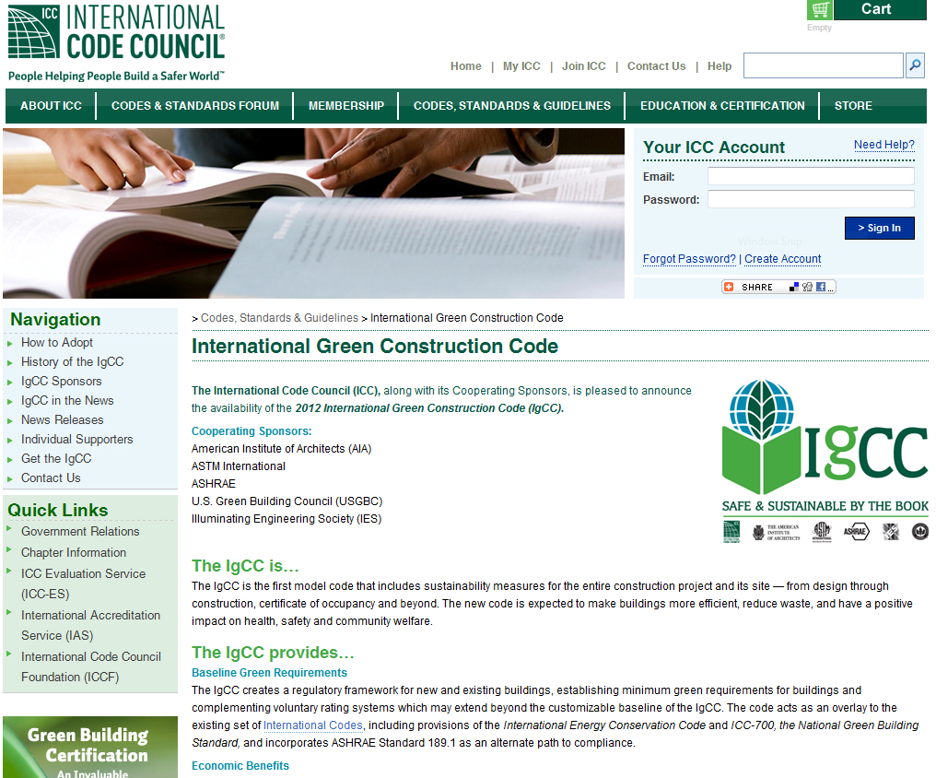
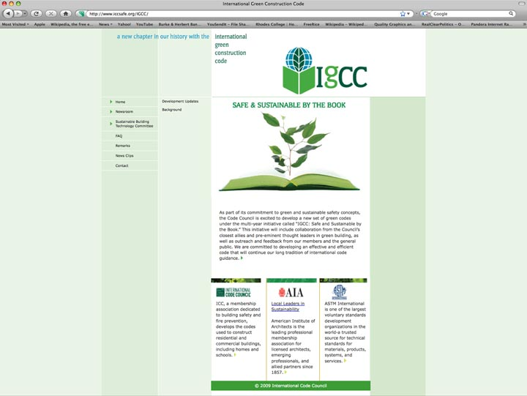
For more information see: www.iccsafe.org/igcc
Notes:
14

